Slide 1
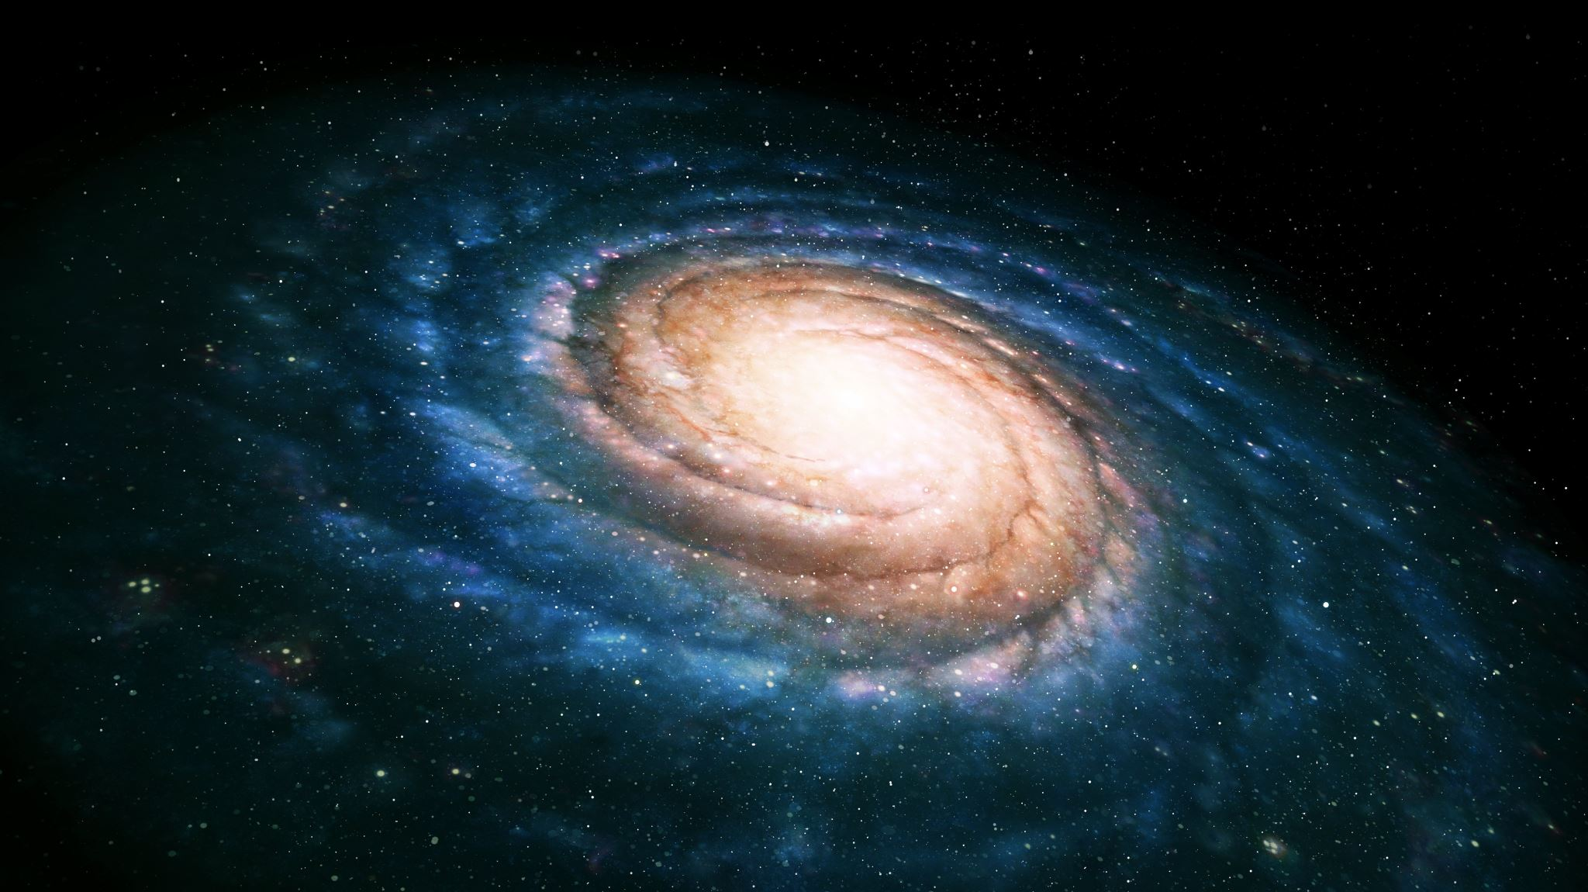

StarDust
A mini game about our galaxy
By Ticala Andreea -Irina

Slide 2
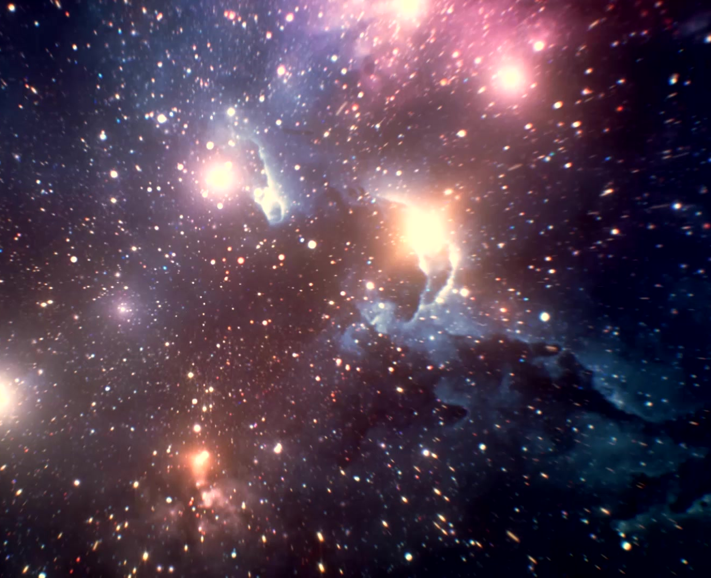
The concept
A “Click-er” type game, with a space thematic, where you take a tour of our solar system from the smallest celestial objects, to the biggest, our sun.

Slide 3
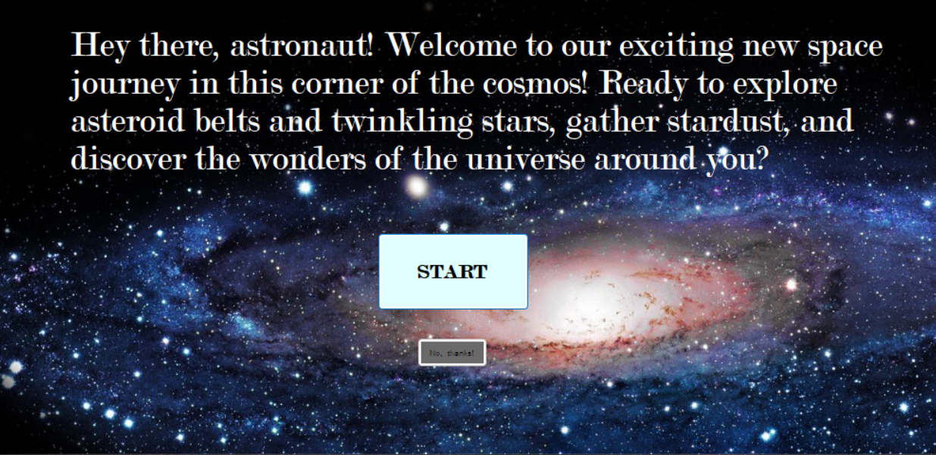
When the “START” button is pressed, another Form will open, starting the actual game. When the “No, thanks!” button is pressed, the present Form will close after 3 consecutive message.

Slide 4
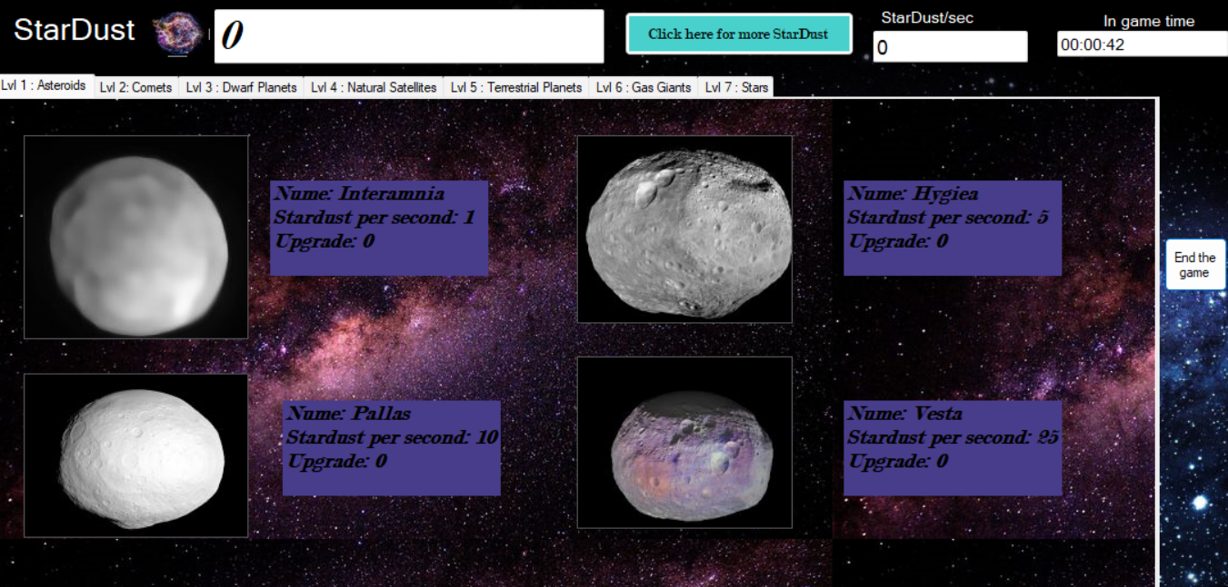

Slide 5
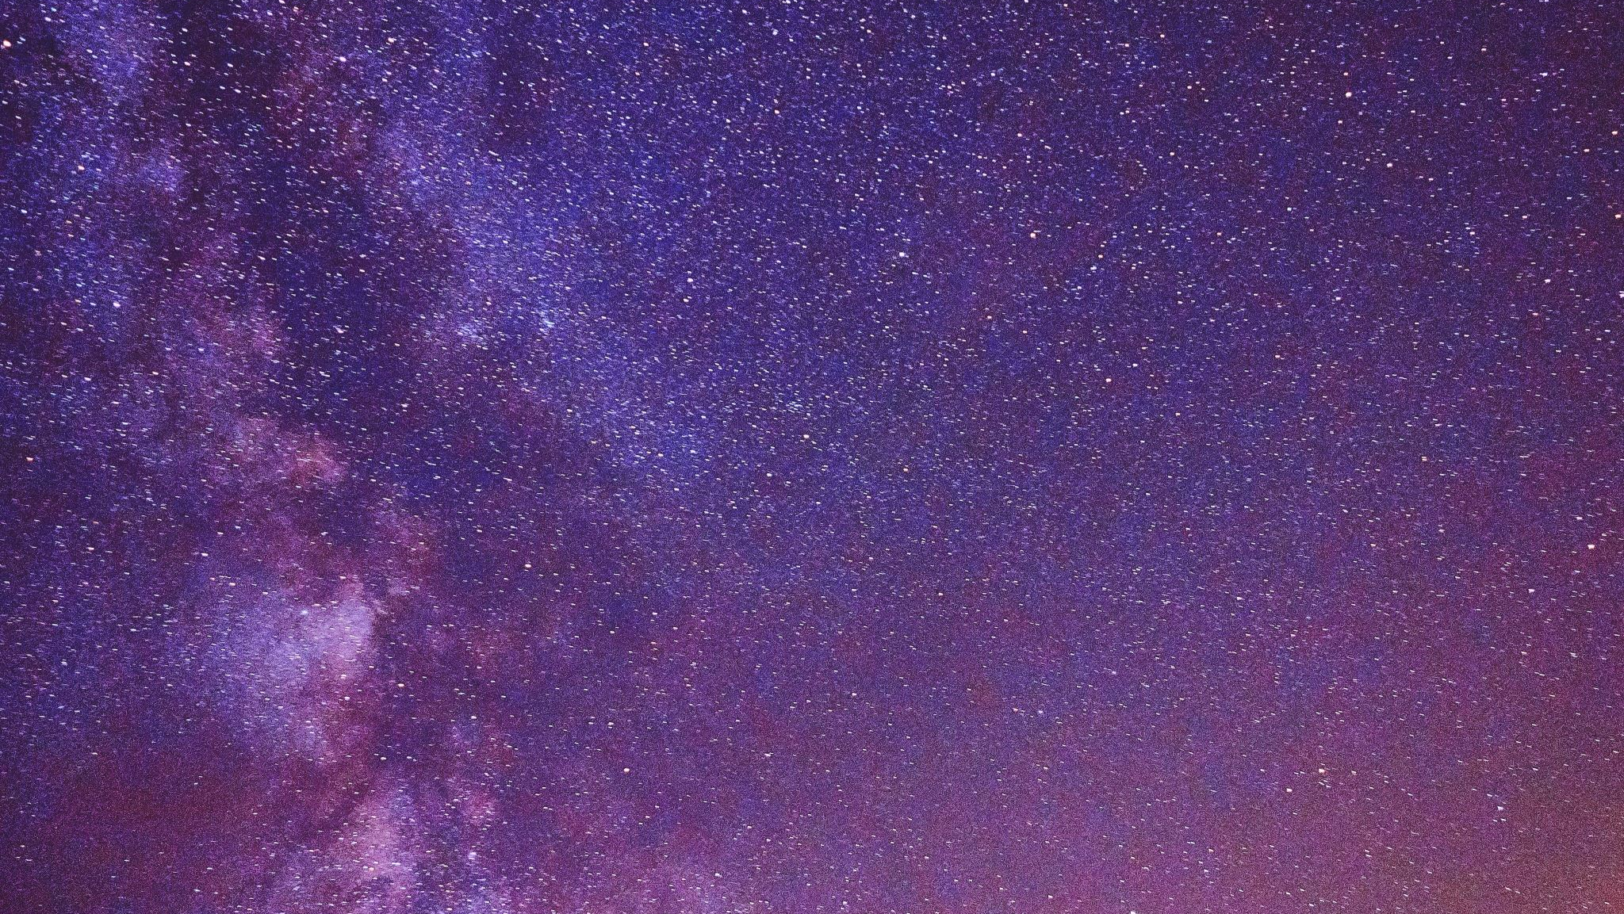

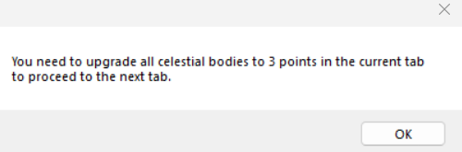
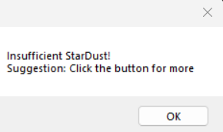
The error messages
If the next tabs are pressed, without the requirements being met, this error message will appear, telling you what you can do.
If the player tries to acquire the asteroids (presumably being at the first level) without having sufficient StarDust an error message will occur.

Slide 6
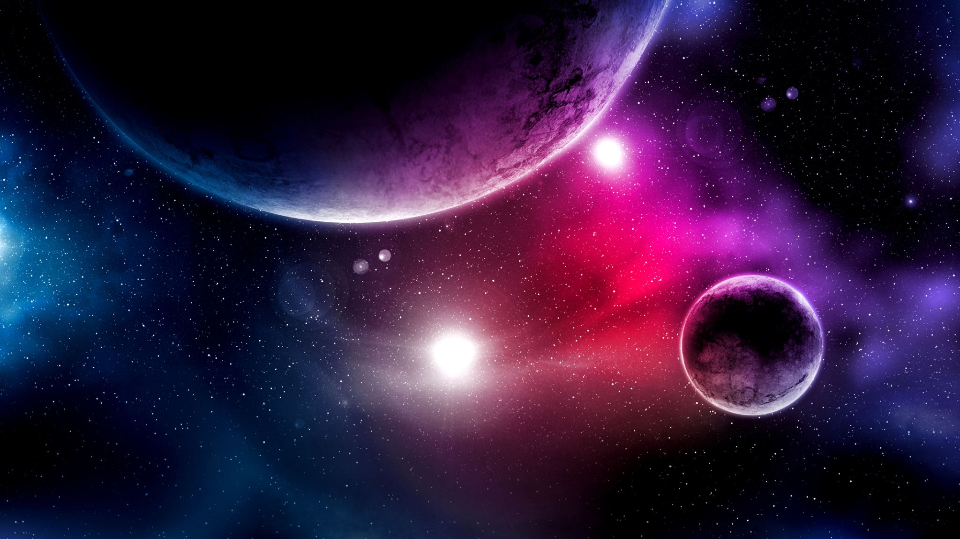
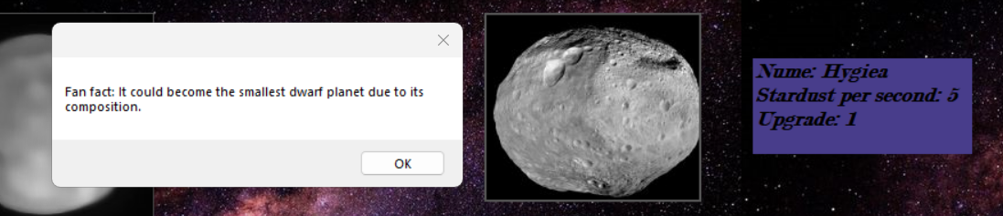
The first tap
The first “tap” on a celestial object will make a pop-up that will give a fun fact about the said space object.

Slide 7
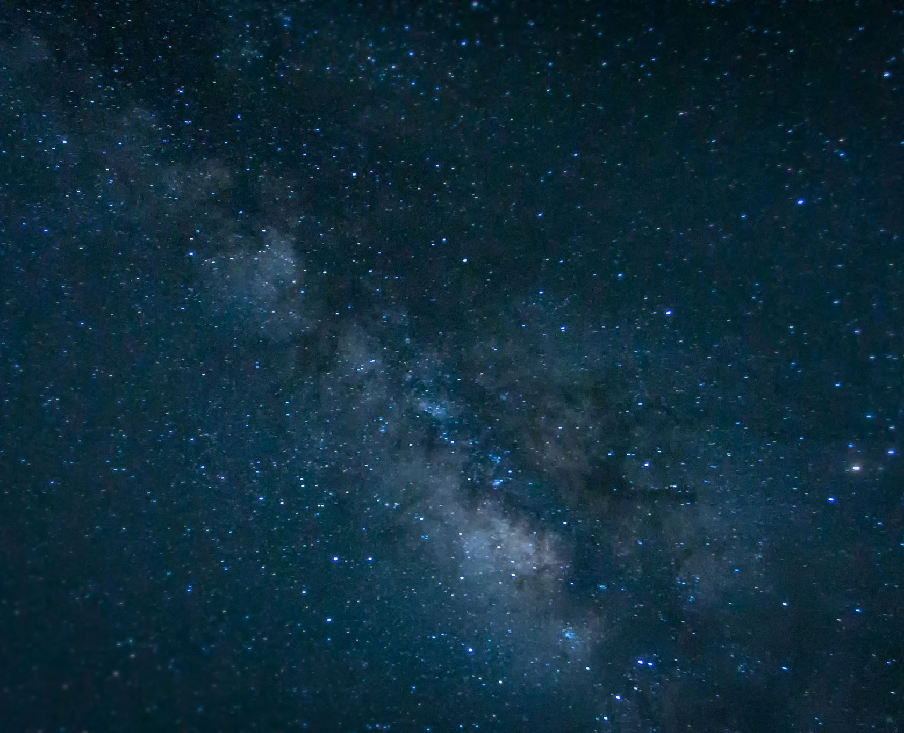
Level up
Updating all the celestial object from the current level 3 times will unlock the next level (unlocking the next tab).

Slide 8
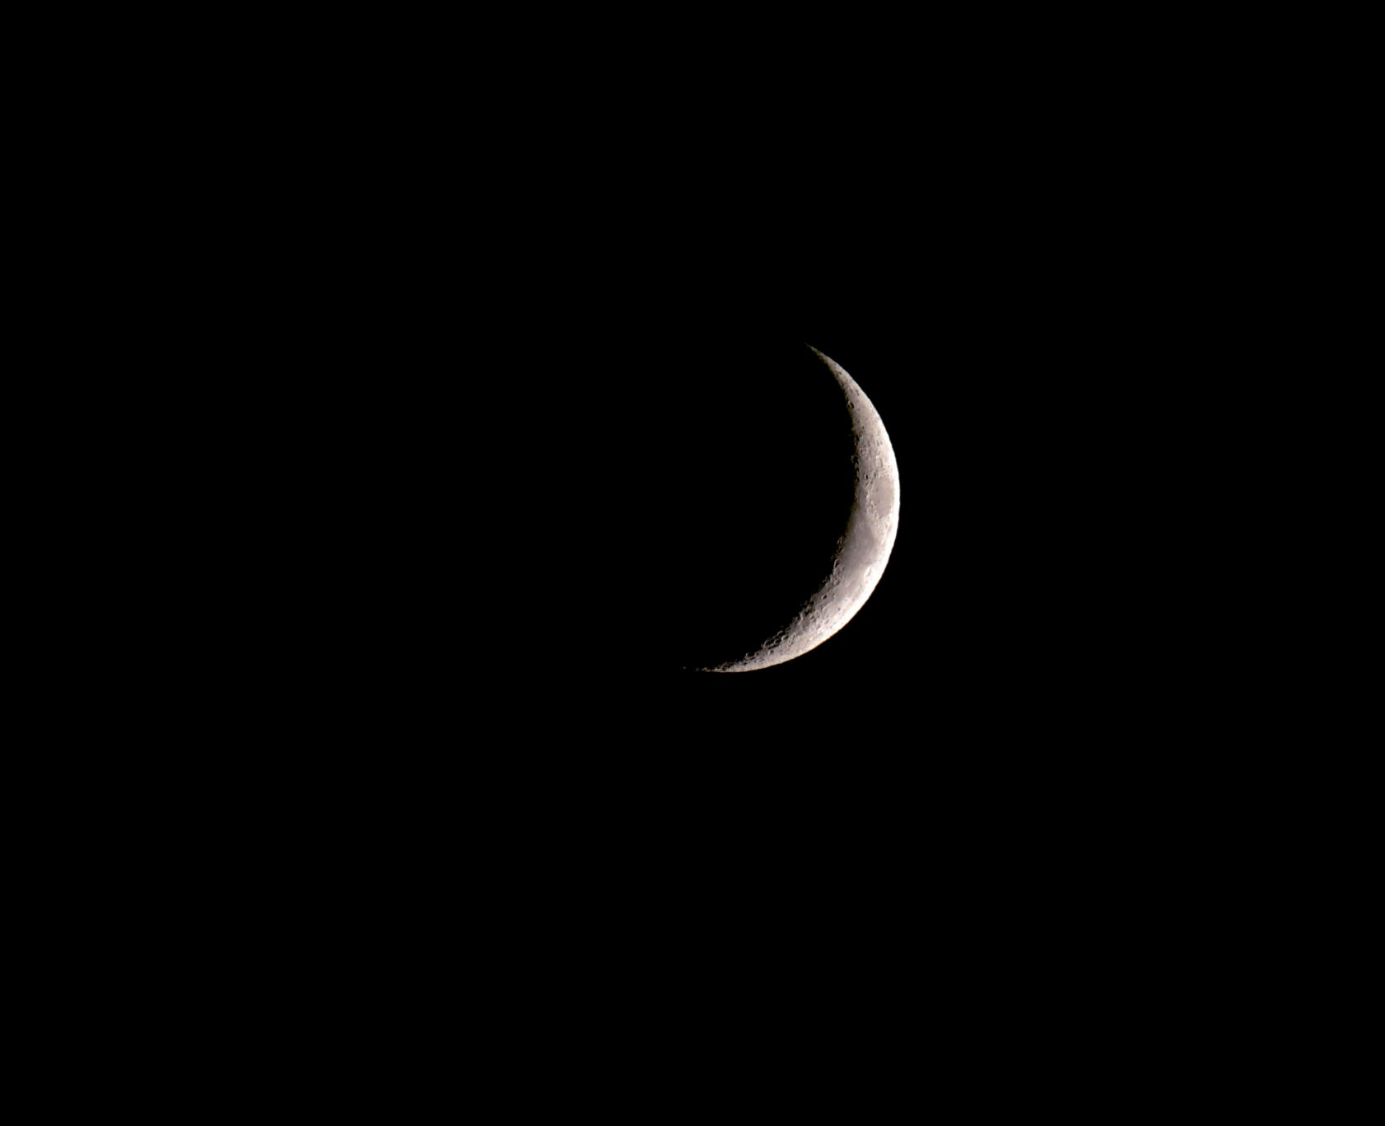
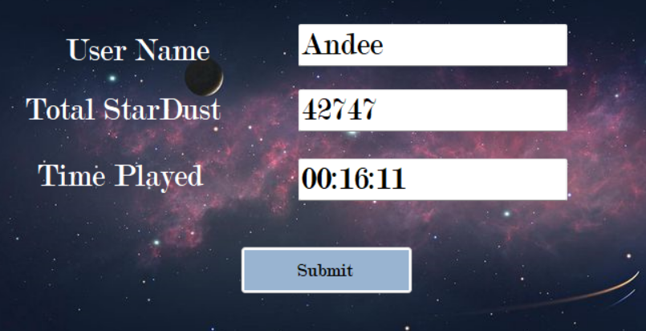
Saving
Winning the game or pressing the “End game” button will give the player an opportunity to save their score in the database of the game, opening the third and final Form. The “Submit” button will be sending the information to the table. Total StarDust and Time Played will be automatically written in the text boxes.

